Slide 1
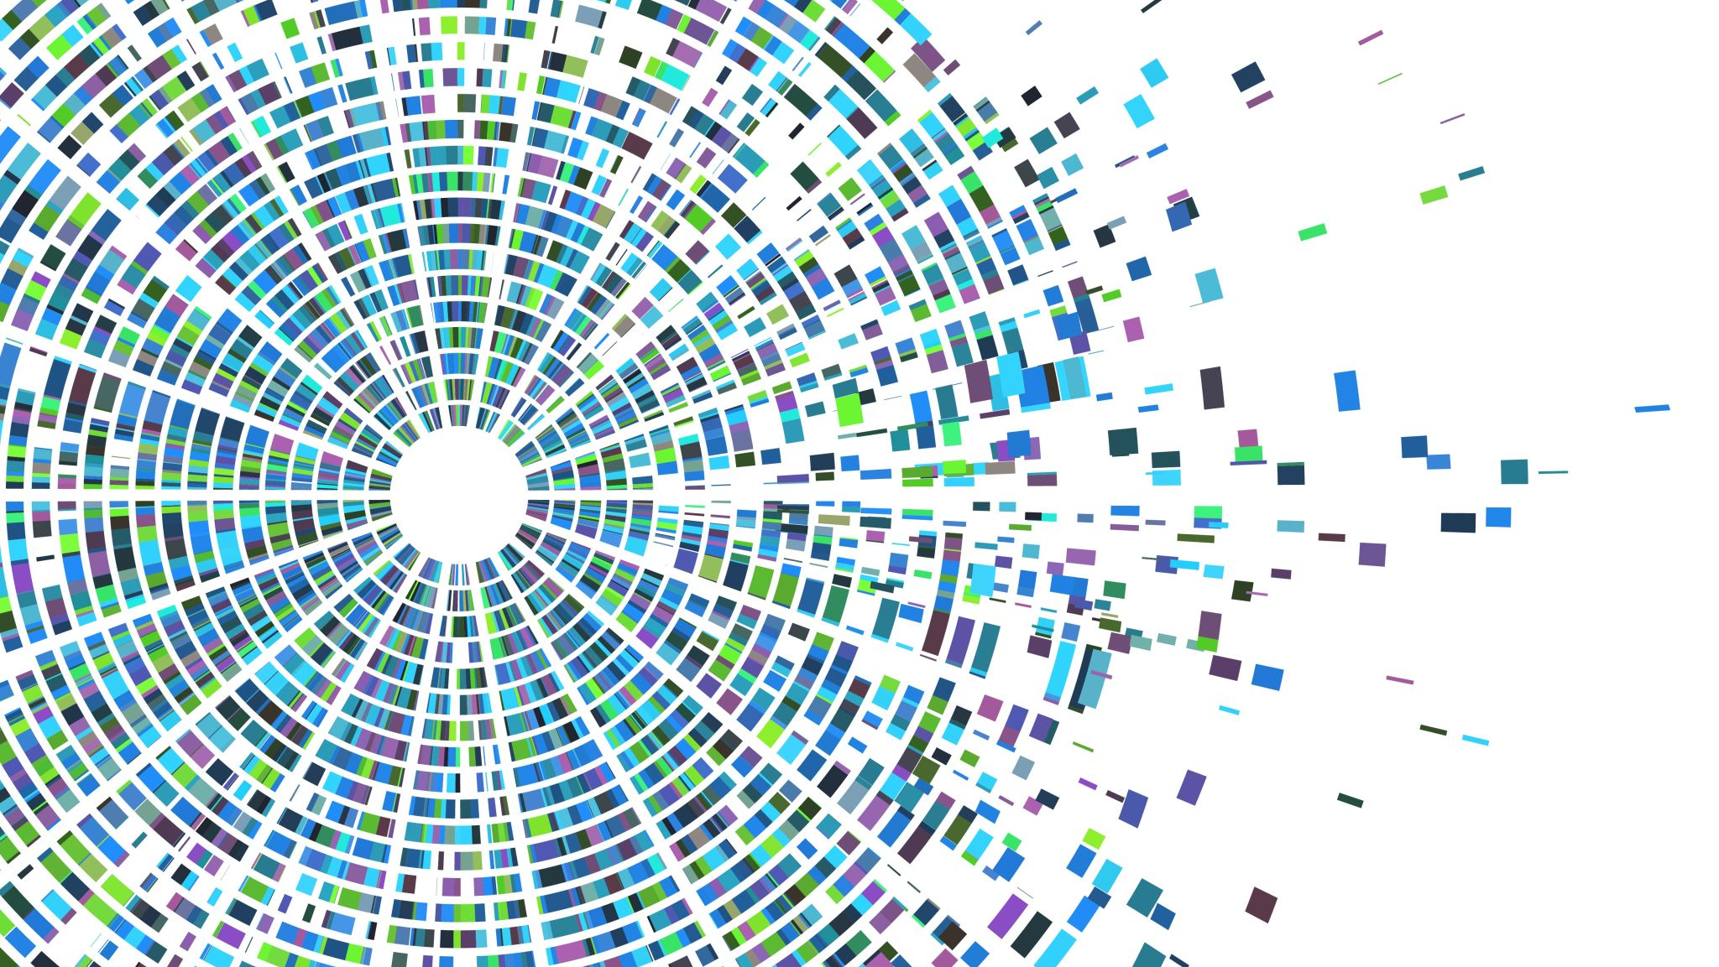
Pi calculation using MapReduce
CS570 Big Data Processing Project
By Arsiema Yohannes

Slide 2
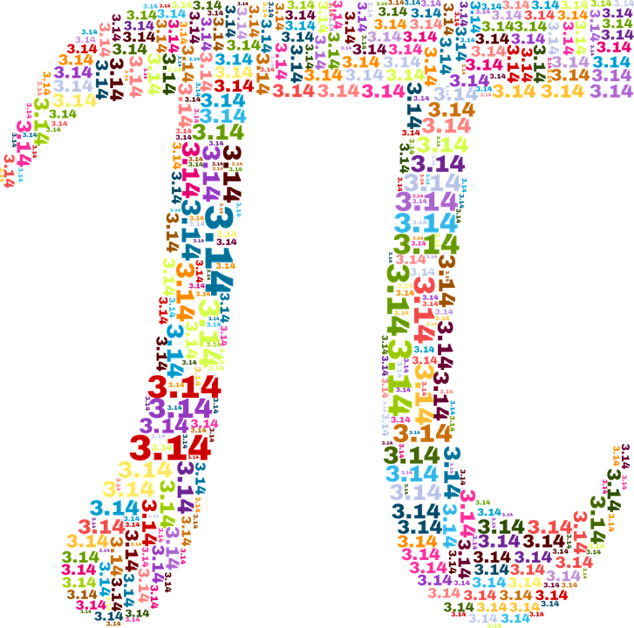
Table of Content
Introduction
Design
Implementation
Test
Enhancement
Conclusion
Reference

Slide 3
Introduction
Objective: Calculate Pi using Hadoop
Note: Hadoop is not ideal for computationally intensive tasks, but this project aims to demonstrate its capabilities
Based on a practice question to gain hands-on experience with Hadoop technology

Slide 4
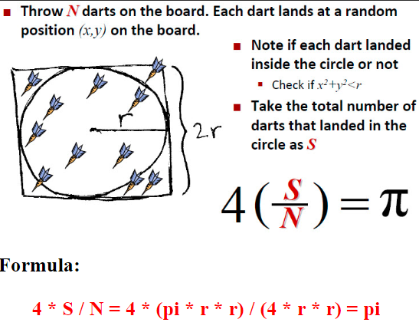
Pi Calculation
As the illustrated on the right, the value of pi can be calculated by counting the number of random darts that falls in the circle and outside the circle.

Slide 5
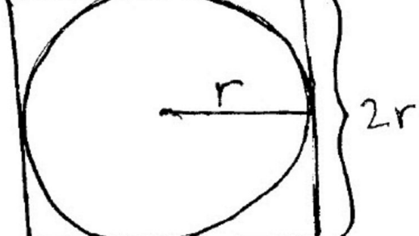
Pi Calculation
How to check if one dart (x,y) lands inside the circle with radius r or not?
(x - center_x)2 + (y - center_y)2 compare r2
Inside: if compare is <
Outside: if compare is >
On the circle: if compare is =

Slide 6
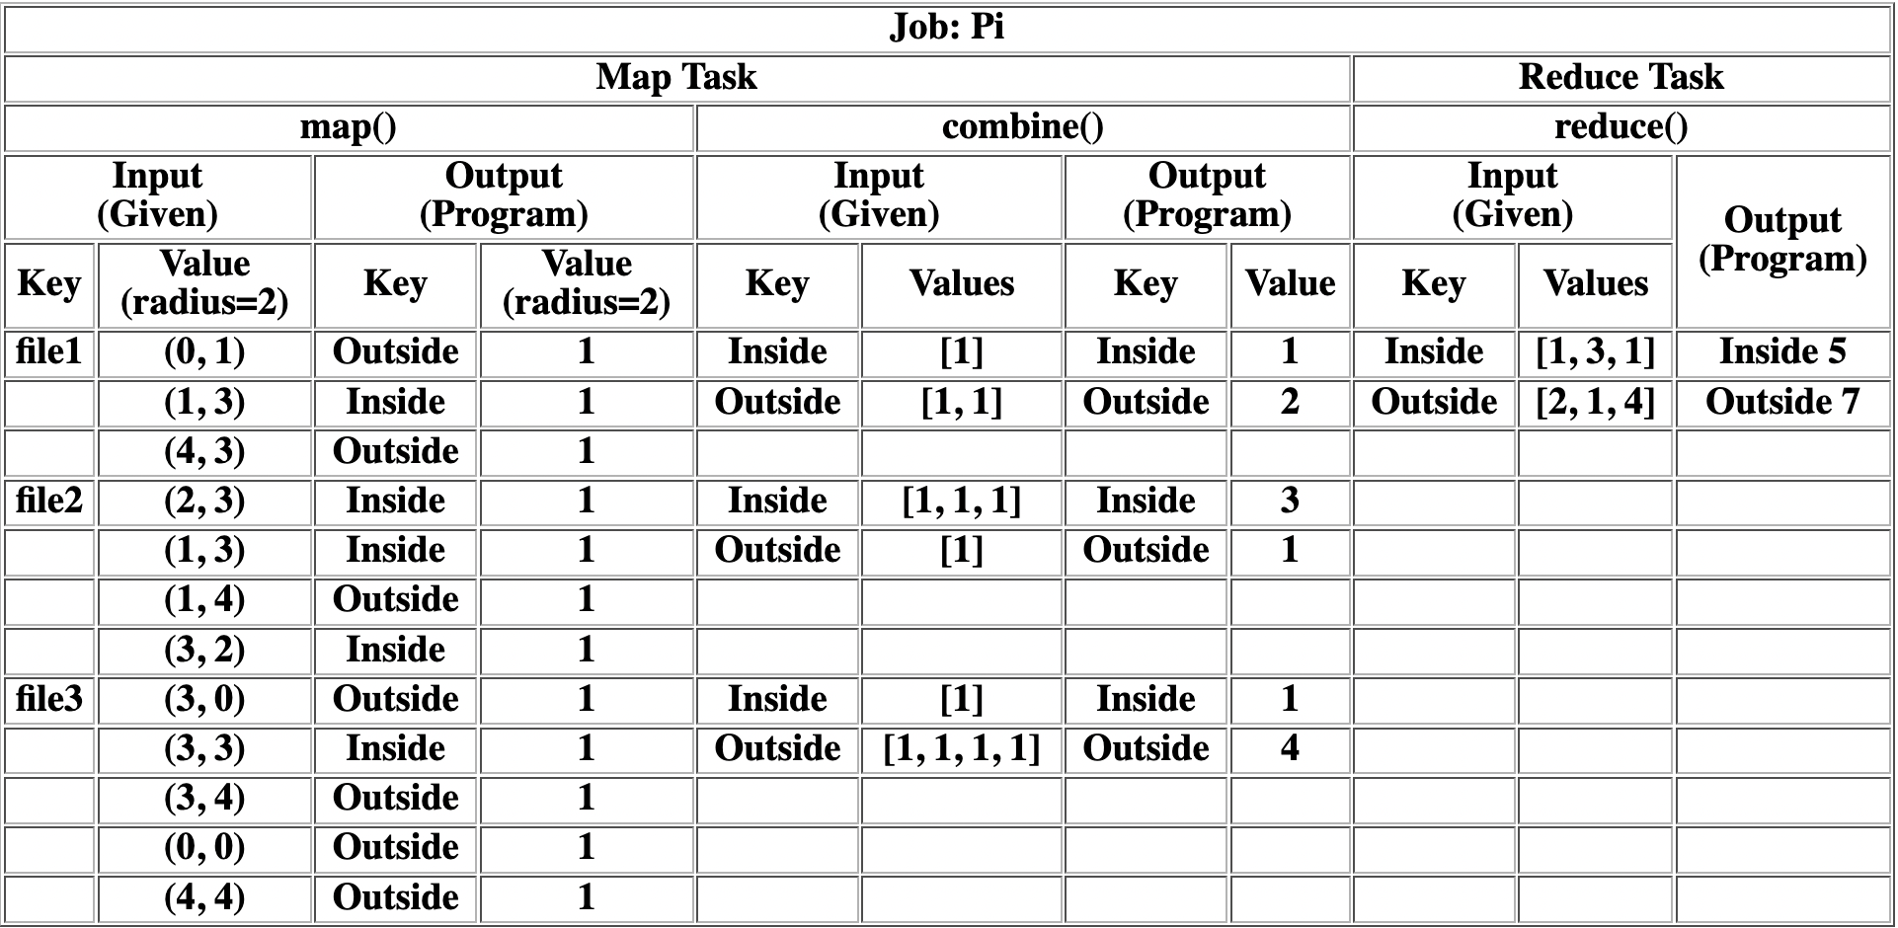
Design

Slide 7
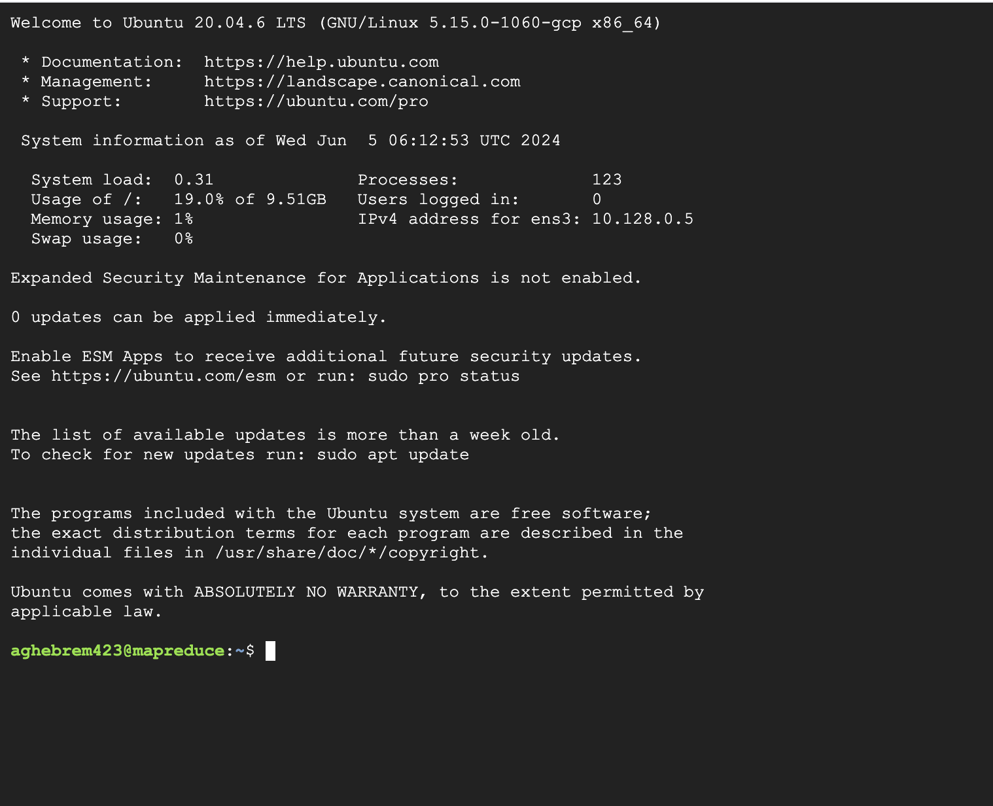

Implementation
GCP
Hadoop
Java

Slide 8
Implementation
Create 3 java files.
GenerateDots.java : Java Program to generate random dot pairs with command line arguments taken in as radius and number of pairs. Output format: x y radius
CalculatePiMR.java: Map(), Reduce() and main() for MapReduce
CalculatePi.java: Java Program to calculate pi value with MapReduce result taken in by reading the file.

Slide 9
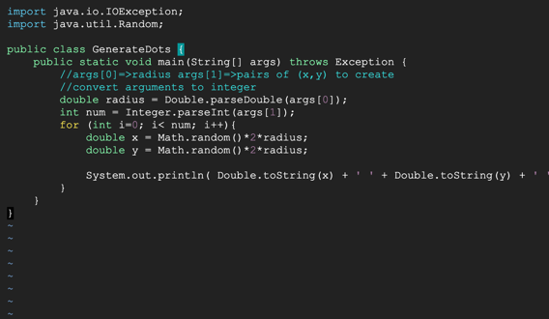
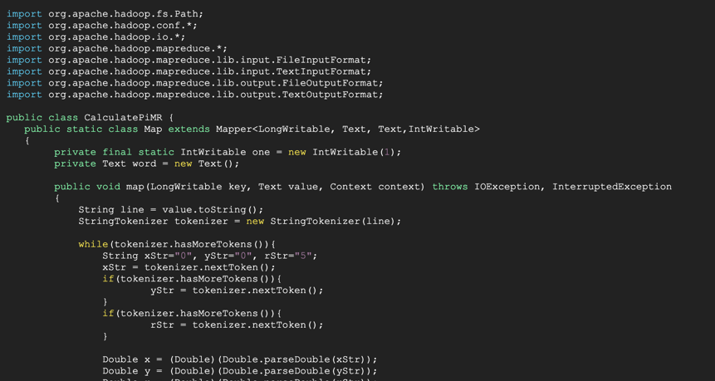
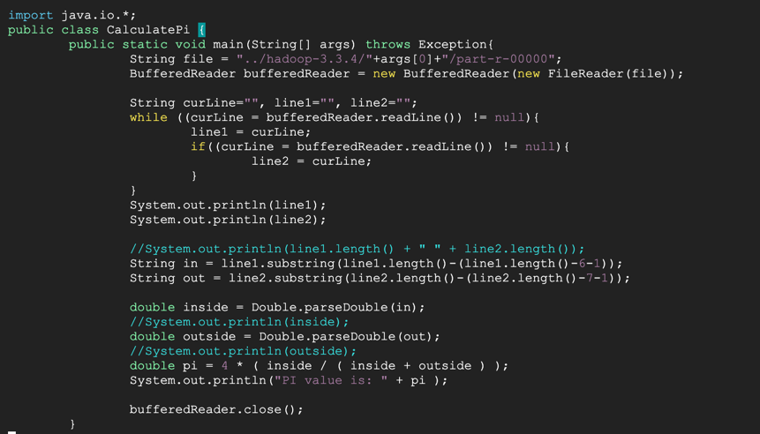

Slide 10
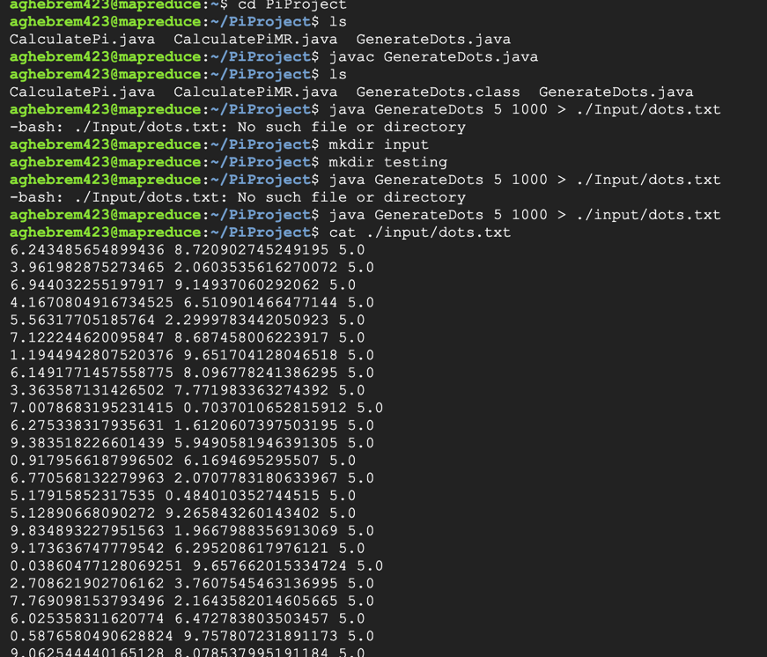
Compile and run java program to generate dots with radius=5, number = 1000

Slide 11
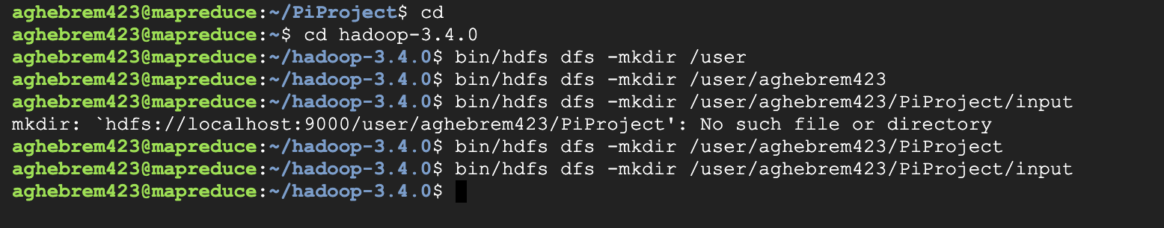
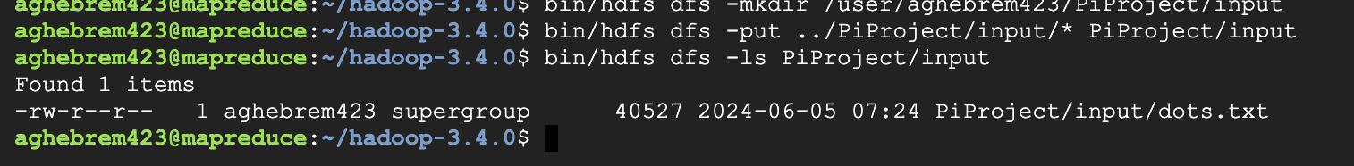
Copy file from local to Hadoop and check.

Slide 12
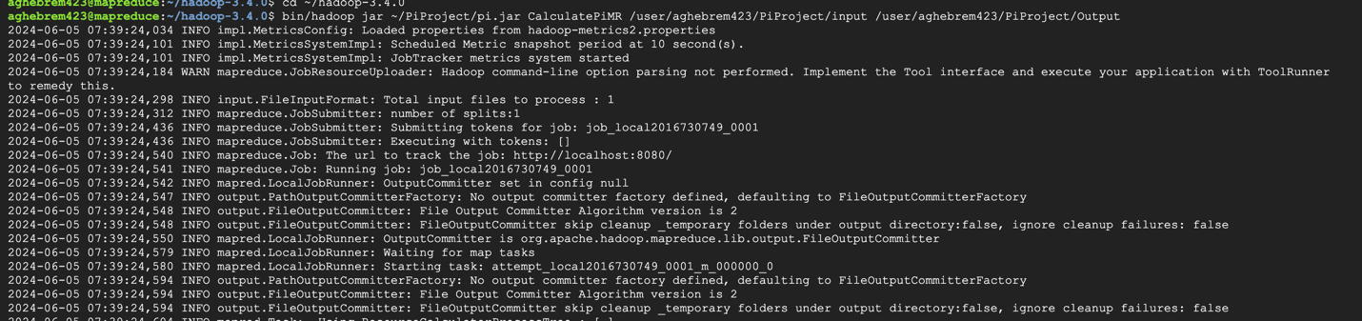
Compile MapReduce program in Hadoop with *.class files created
Create .jar file with *.class files
Run MapReduce Program with input file and save result in Output

Slide 13
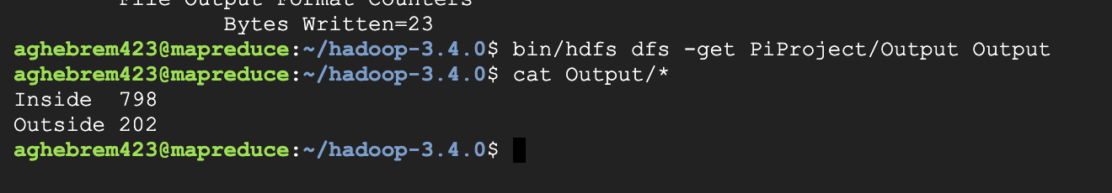
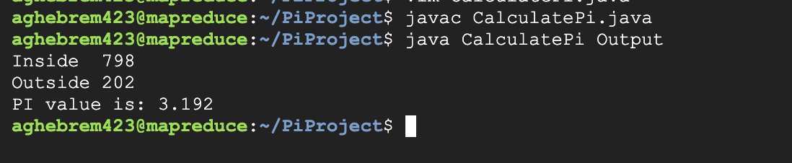
Test
Get output and save to local, the show output.
Using the output (local output folder as command line arguments) from MapReduce Program to compile and run java program to get pi value.

Slide 14
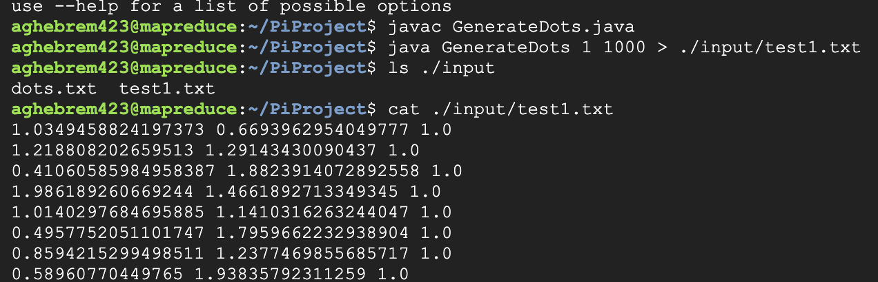
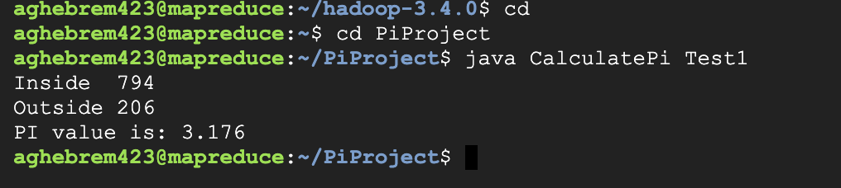
Enhancement
Since, the PI number is close but a bit off we will try to decrease radius or increae number to see the changes they will make.
Enhancement: Decrease radius

Slide 15
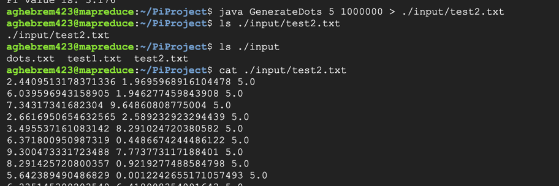
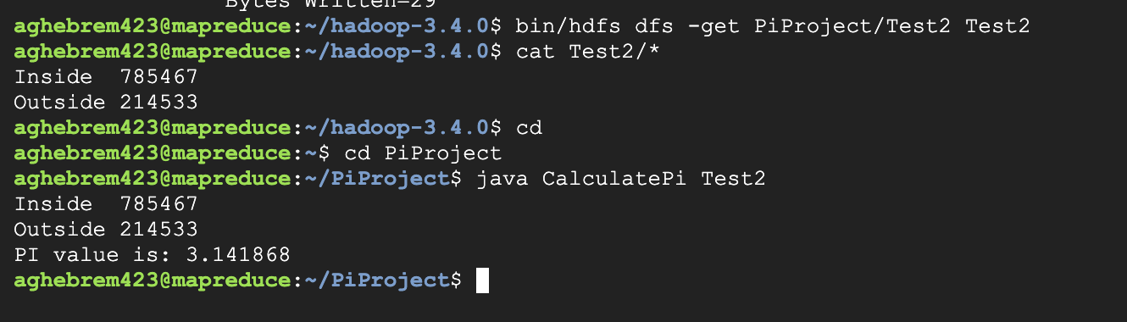
Enhancement : Increase number.
Increasing number made the PI number very close.

Slide 16
Conclusion
The Pi algorithm is concise and clear that,
N should be large
Points should be chosen uniformly at random
Hence, we should increase the the number of random values to get accurate result of Pi.

Slide 17
Reference
Hadoop mapreduce to calculate Pi
MapReduce Tutorial
Pi Computation With MapReduce
Hadoop: Setting up a Single Node Cluster.

